Slide 1
Business Insights
Google pay market share analysis
By SHAILJA KANT MISHRA

Slide 2
Objective / Problem statement
“Analyze customer transaction data to identify top apps , trends and actionable insights”
Despite being a major UPI player, Google Pay(35%) lags behind PhonePe(49%), highlighting a significant performance gap in the UPI ecosystem.

Slide 3
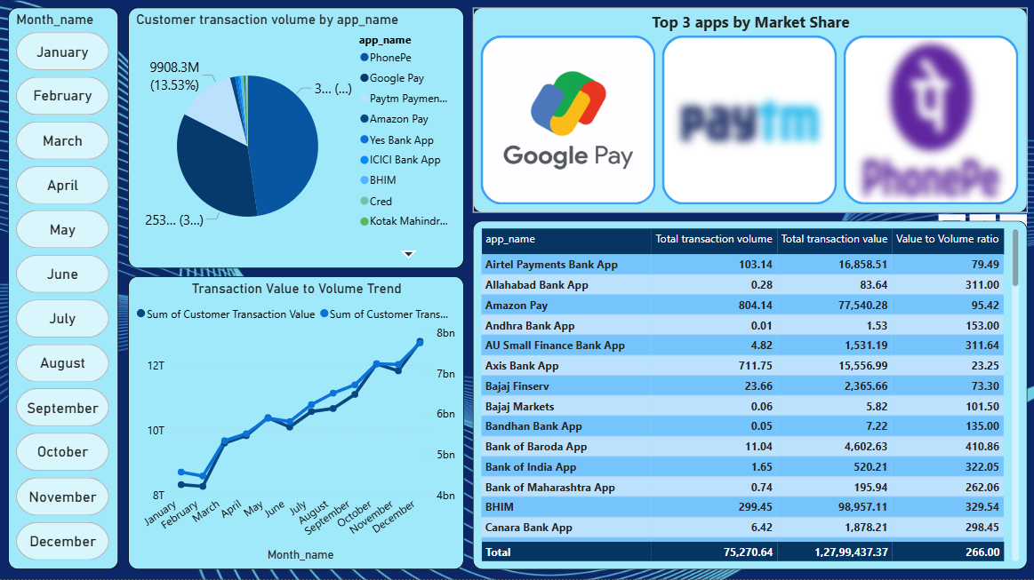
Dashboard Overview

Slide 4
Key Insights
PhonePe leads the UPI market with highest transaction share, followed by Google Pay
Paytm ranks third, while other app capture relatively smaller volumes.
Top banks by app usage includes SBI, Axis, HDFC – together contributing to the major portion of the total transactions.
Overall market concentration ; Top 3 apps dominate significantly, highlighting limited competition from smaller players.

Slide 5
Why Google Pay is lagging behind how to fix it
Possible solutions :
Focus on High-value transactions (Bills, shopping, travel booking tie-ups.
Regional penetration - Marketing push in tier-2 and tier-3 cities where PhonePe is aggressive
Cashback and Loyalty programs for customers and also for merchants.
Promoting features like UPI Lite and credit on UPI .

Slide 6
Conclusion
By focusing on high-value transactions, strengthening loyalty pragrams, expanding regional presence, and leveraging UPI innovations, Google Pay can not only bridge the gap with PhonePe but also establish long-term customer stickiness and sustainable market growth.

